Slide 1
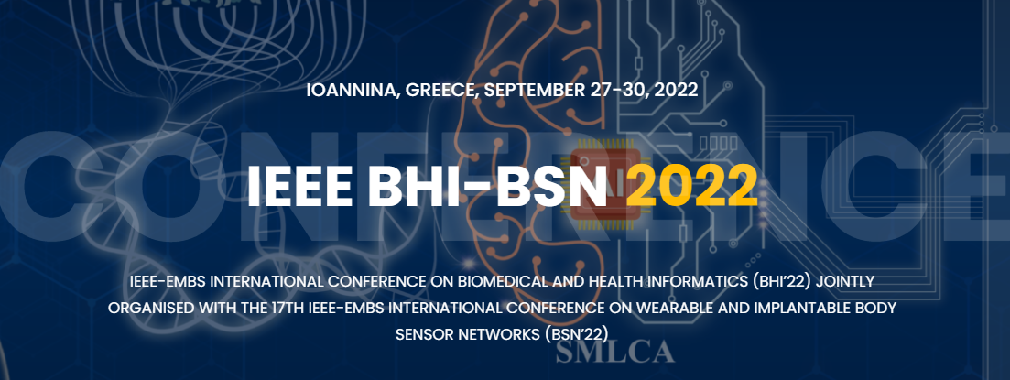
Workshop title: Developing open, standard-based, interoperable Cancer Imaging Repositories in Europe: Issues, Experiences and Challenges
www.bhi-bsn-2022.org
Organizers
Short Description
Contents
CVs of the Organizers
Prof. Manolis Tsiknakis, FORTH-ICS & Hellenic Mediterranean University Prof. Karim Lekadir, Universitat de Barcelona
The AI4HI Network includes five large EU-funded projects on big data and AI in cancer imaging (CHAIMELEON, EUCANIMAGE, INCISIVE, ProCancer-I, PRIMAGE and has been organized into 8 working groups (Ethical and legal issues, Metadata interoperability, Data storage and management, Data annotation, AI development, AI validation, Clinical Working Group and Outreach Working Group), each consisting of 15 experts representing the five projects and a wide range of stakeholders, perspectives, approaches and disciplines. This workshop will focus on presenting the results delivered by these working groups analyzing the existing landscape, solutions and challenges based on a concrete set of clinical use cases related to a number of cancer types (lung, breast, liver, colorectal, prostate, brain, etc).
Keynote: Developing a Cancer Imaging Repository in US (30min) Strategic and Methodological issues related to AI in Health Imaging (6x15min = 90 min) FUTURE-AI guidelines for trustworthy and deployable AI The concept of a Model’s Passport AI explainability paradigms Federated learning & Inference Services Approaches for AI model development in health imaging and initial results AI approaches for image harmonization | Ethical/Legal (4x15min = 60 min) GDPR compliance and governance models Ethical and legal aspects from technology point of view Ethical and legal aspects from technology point of view Project data sharing, policies, approaches, challenges Technical (5x15min = 90 min) Data annotation & image segmentation Data interoperability through common data models Common data models for non-imaging data Extending OMOP-CDM for imaging data Infrastructures for storage and management of health imaging data.
Prof. Manolis Tsiknakis (M), is a Professor of Biomedical Informatics and eHealth at the Department of Informatics Engineering at the Technological Educational Institute of Crete and a visiting Professor at FORTH/ICS. He is the author of over 300 publications. His main areas of expertise include approaches for semantic health data integration and interoperability of health information systems; affective computing and its application in developing smart eHealth solutions; service platforms for pervasive eHealth and mHealth services (h index: 37). | Dr Karim Lekadir is a Ramon y Cajal senior researcher at the BCN-MedTech Centre of the Universitat Pompeu Fabra, Barcelona. His current research focuses on the development of data science and machine learning approaches for the analysis of large-scale biomedical data. He is the Project Coordinator of the recently funded euCanSHare H2020 project (2018-2022), leading a consortium of 16 institutions to address data sharing and big data approaches in cardiovascular personalised medicine. He is an Associate Editor of the IEEE Transactions on Medical Imaging.

