Slide 1
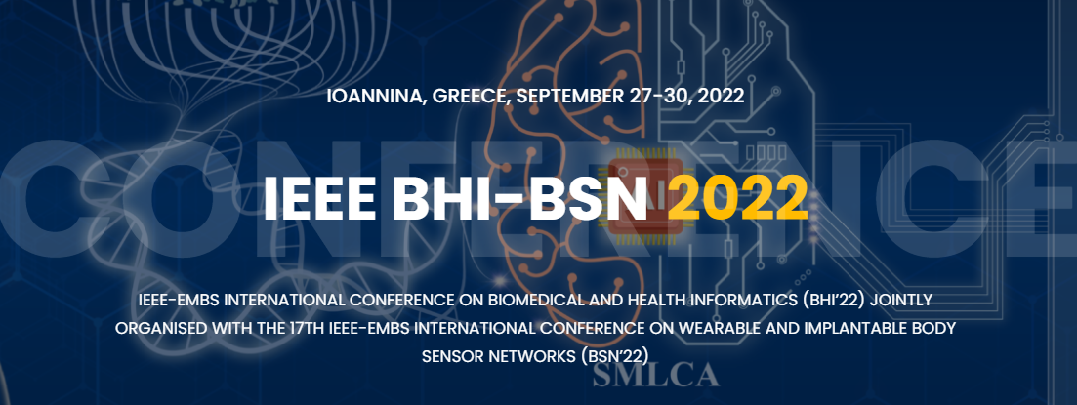
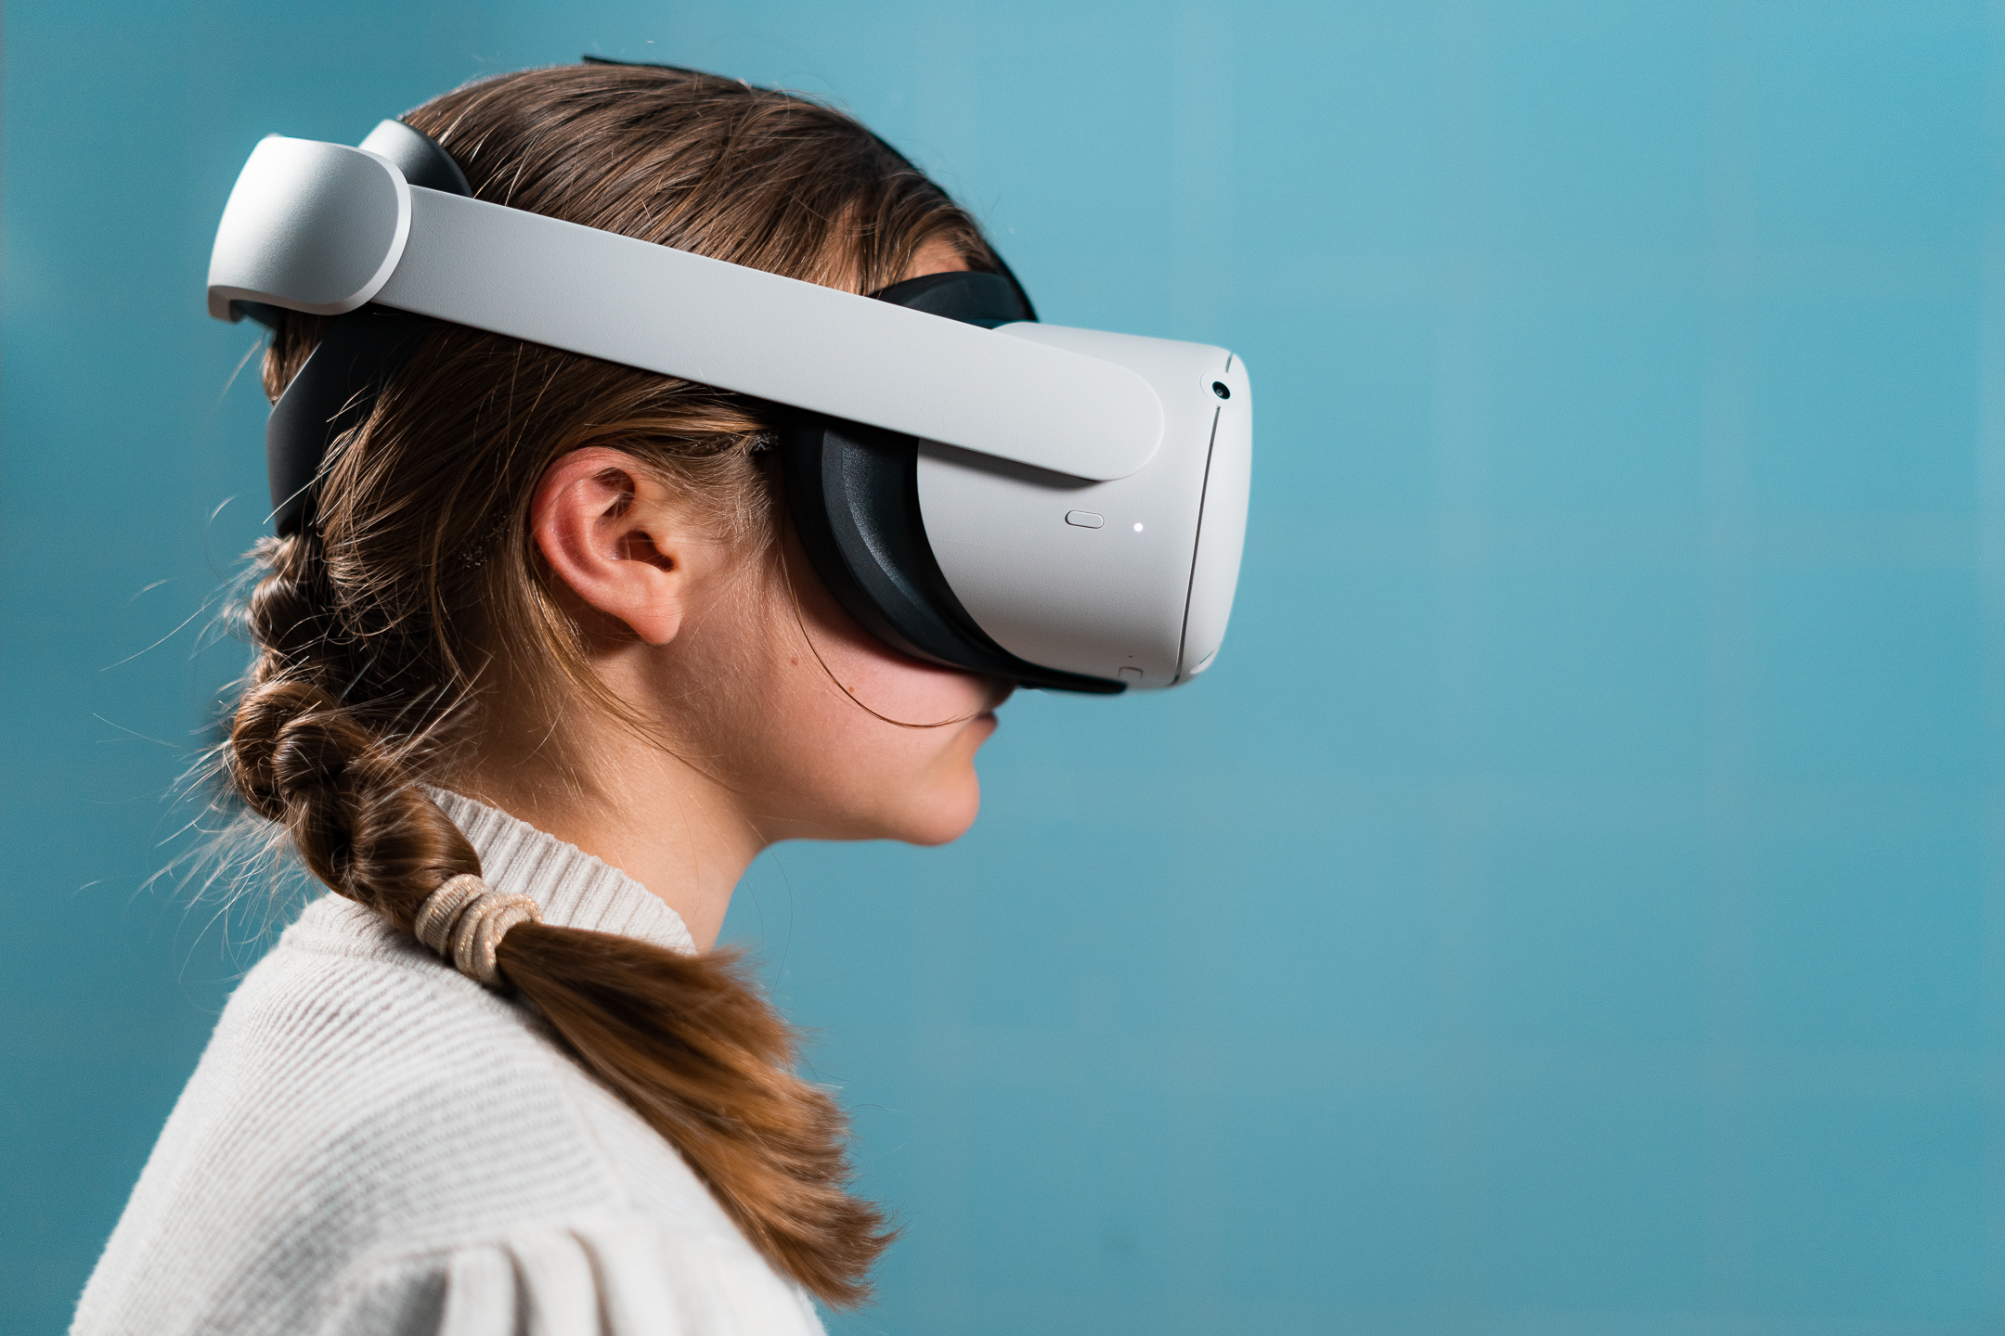
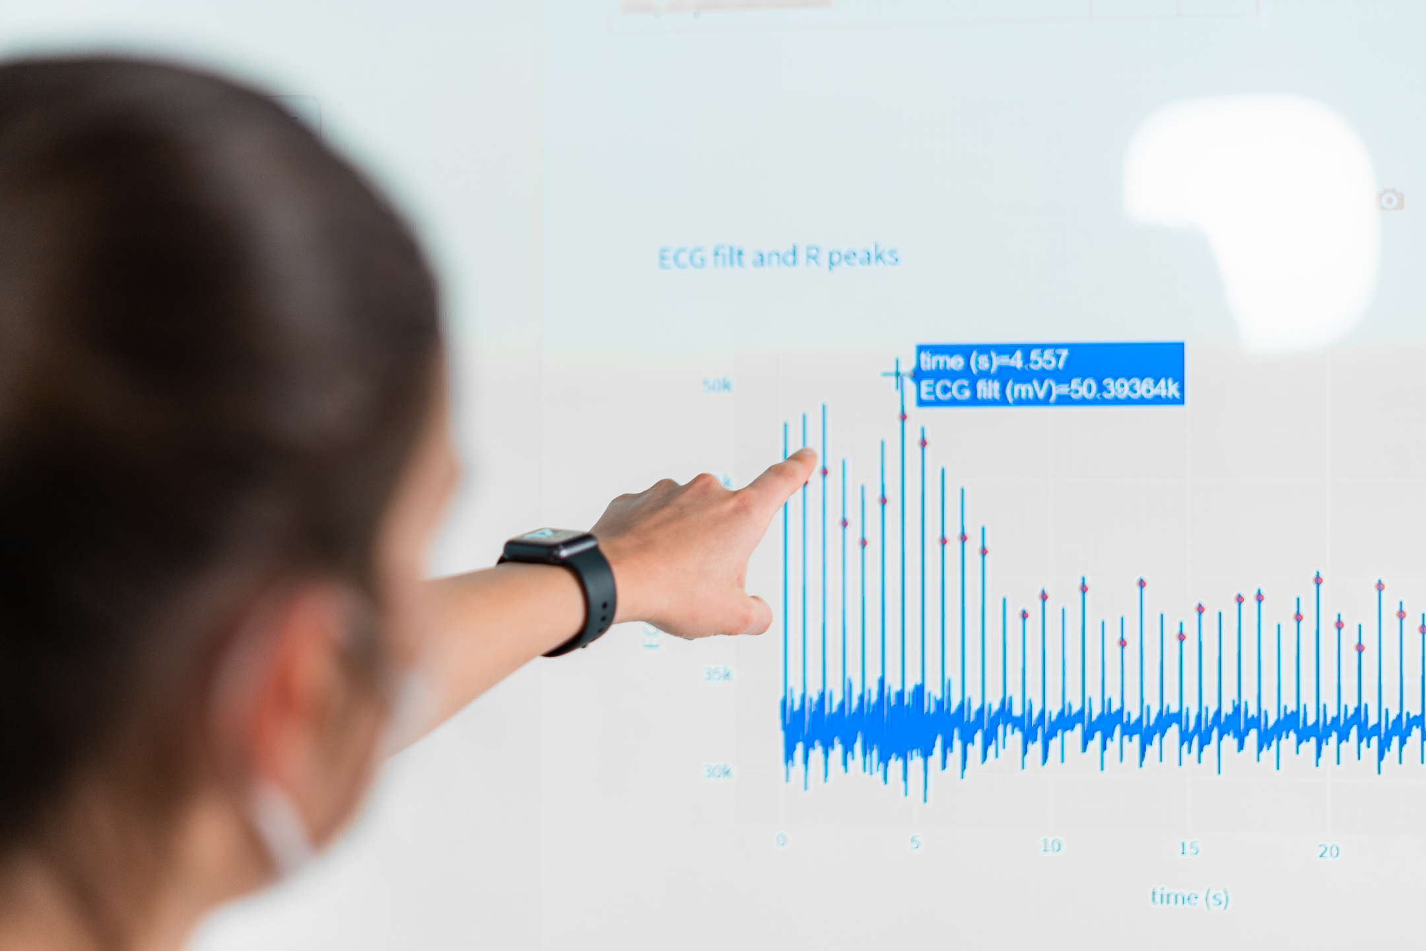
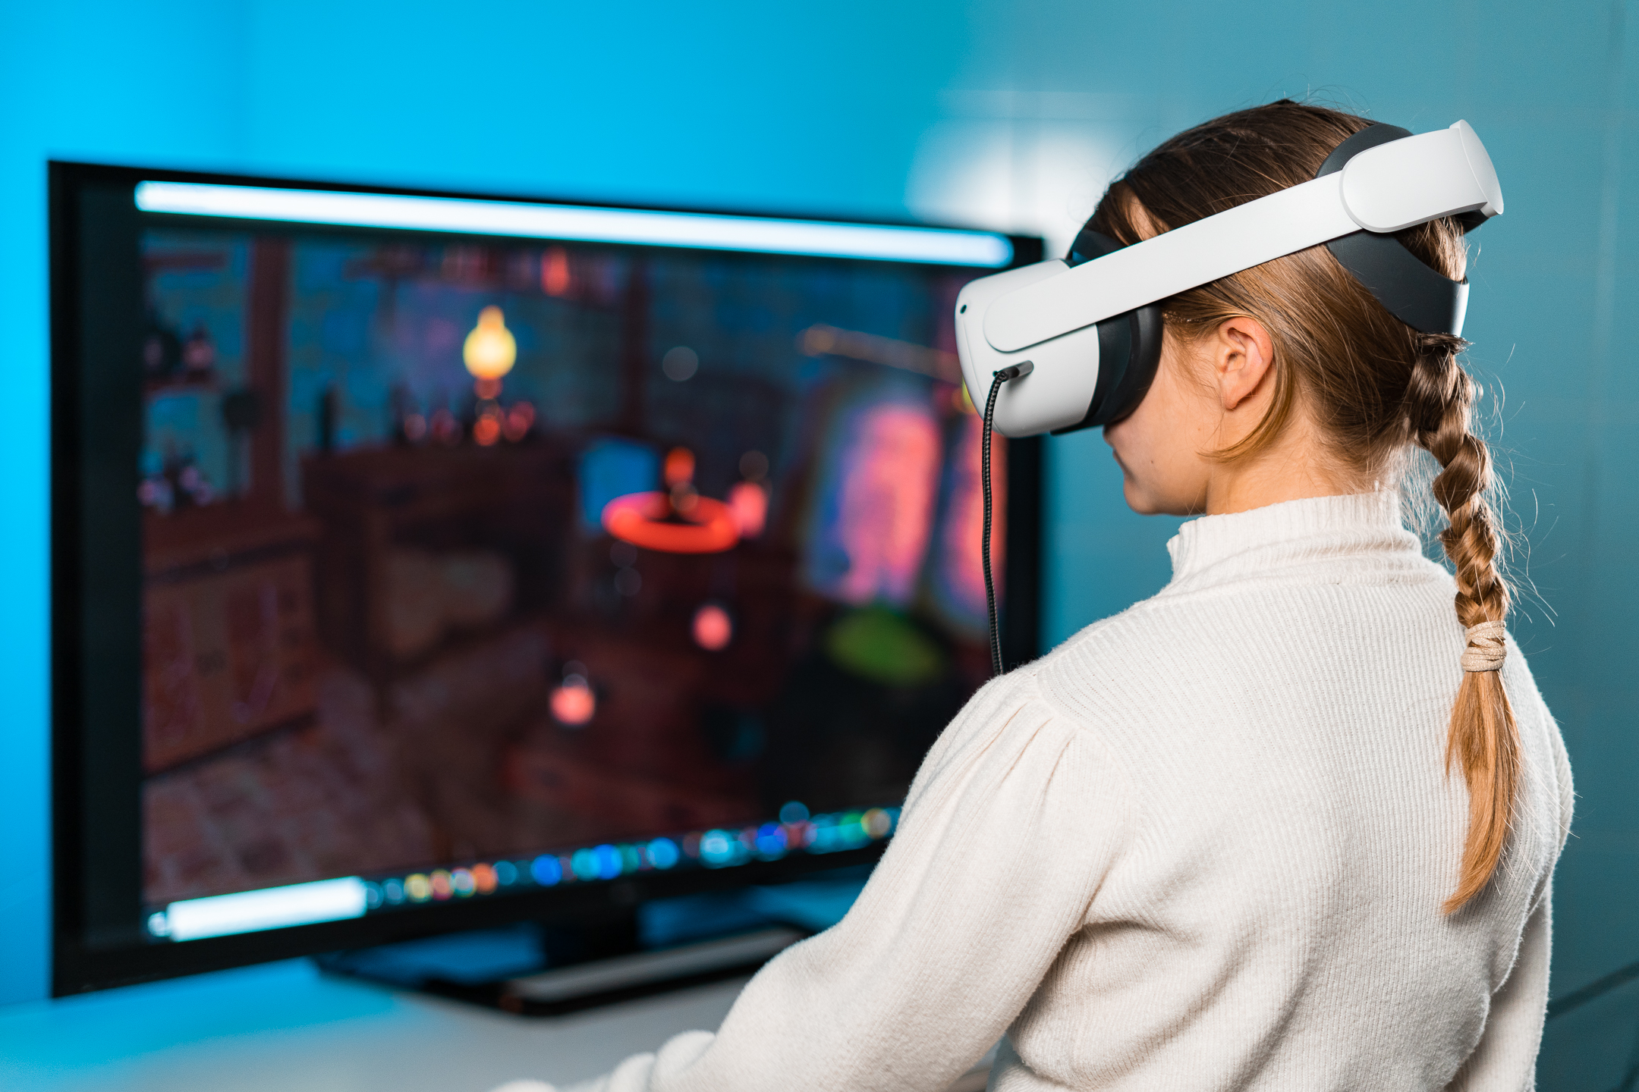


Workshop title: The potential of enabling technologies in tailoring and adapting neuromotor and cognitive rehabilitation in children
www.bhi-bsn-2022.org
Organizers
Short Description
Contents
CVs of the Organizers
Dr Ilaria Bortone, Senior Postdoc Research Fellow, Institute of Clinical Physiology, National Research Council (IFC-CNR), Pisa, Italy
Dr Lucia Billeci, Full-term Researcher, Institute of Clinical Physiology, National Research Council (IFC-CNR), Pisa, Italy
Rehabilitation is essential, along with prevention, promotion, treatment, and support, in ensuring healthy lives and promoting well-being for all at all ages. This becomes particularly true in the pediatric population, where neuromotor or neurocognitive impairments, causally and clinically heterogeneous, occur in a challenging developmental context. Wearables, sensing, immersive virtual environments and social robotics offer the opportunity and challenges to develop novel methods for implementation of advanced and adaptive therapies in terms of engagement, proposed tasks, data analysis and feasibility of the system in the clinical setting.
The symposium aims to gather knowledge and foster research interest into wearable devices for biosignals collection and serious games applied to rehabilitation scenarios by providing a forum for different stakeholders to exchange ideas and promote collaboration.
- Enabling Technologies in Adaptive Neuro Motor and Cognitive Rehabilitation of children with developmental disorders; I. Bortone & L. Billeci (National Research Council, Italy)
- Social Robotics for Neurodevelopmental Disorders; S. M. Anzalone (Paris 8 University, France)
- Real-time music composition based on AI emotion recognition; T. Colafiglio, P. Sorino & D. Lofù (Polytechnic of Bari, Italy)
- Round table with stakeholders (academia, healthcare professionals, companies, …)
Ilaria Bortone, Eng, PhD, almost 10 years of expertise in physiological data acquisition, processing and analysis. Leader of 3-year research project on the promotion of motion analysis in the healthcare sector (KISS-Health), she is currently the co-leader of “TELOS - Tailored neurorehabilitation thErapy via multi-domain data anaLytics and adaptive seriOus games for children with cerebral palSy”, funded under the call “Bando Ricerca Salute 2018” of Tuscany Region, Italy (CUP J52F20001040002).
Lucia Billeci, Eng, PhD, over 10 years of expertise in analysis of neuroimaging, electrophysiological and physiological signals by means of bioengineering methodologies, mainly applied to neurological, psychiatric and neurodevelopmental disorders. She participated in the EU Project “MICHELANGELO: Patient-centric model for remote management, treatment and rehabilitation of autistic children” (FP7 Grant agreement ID: 288241).

