Slide 1
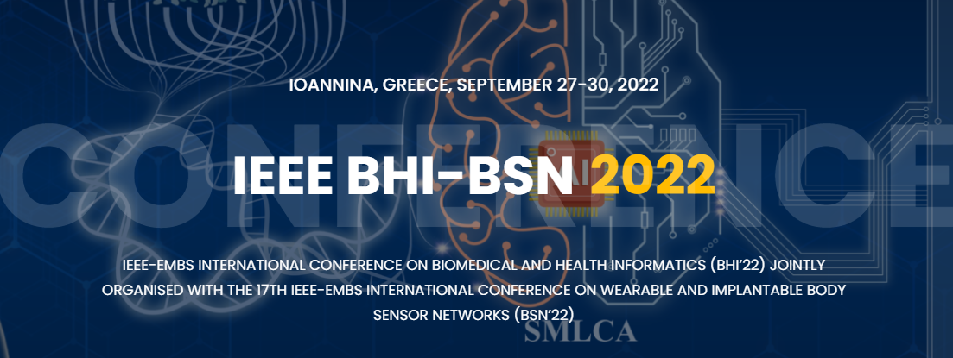
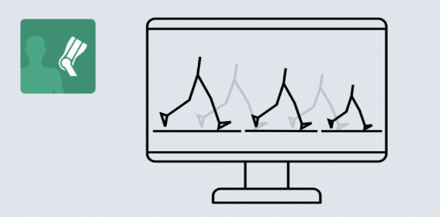
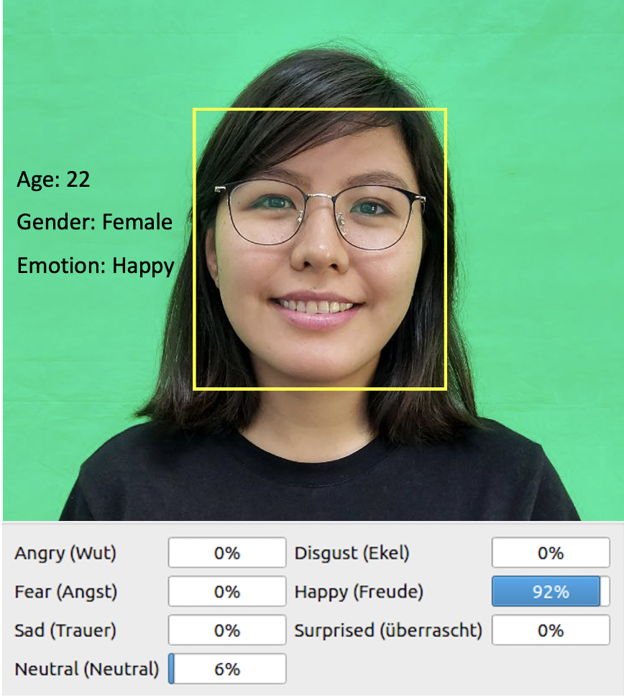
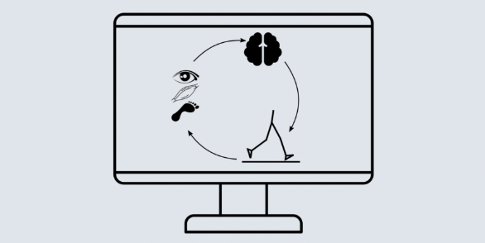
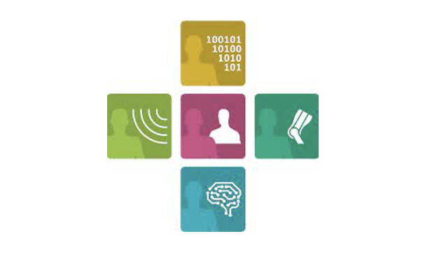
Workshop title: Understanding Inner States of Humans using Measurements of “Invisibles” - ”Empatho-Kinaesthetic” Sensing
www.bhi-bsn-2022.org
Organizers
Short Description
Contents
CVs of the Organizers
Prof. Bjoern M. Eskofier, Machine Learning and Data Analytics (MaD) Lab, FAU
Prof. Anne Koelewijn, Junior Professorship for Computational Movement Science, FAU
Prof. Martin Vossiek, ﻿Institute of Microwaves and Photonics, FAU
Co-organizers: Misha Sadeghi, Falk Pulsmeyer
Every movement of the body of a living being is the result of mechanisms of action taking place inside of the body and interactions between them. The body's motor functions are initiated and regulated by neuronal processes and, more complex movements, controlled by sensitive body perception and cognition. Depending on the physical constitution, state of health or stress, and movements, parameters of the (interaction) mechanisms change. We call this concept “empatho-kinaesthetic” sensing.
The symposium will focus on new ideas, sensors, and technologies such as radar, radio, laser, and camera sensors (called “Invisibles”) to improve the diagnosis process and the daily lives of patients and physicians. It will bring together technical experts in biomedical signal processing and physicians specializing in patient care. The symposium will provide a forum for academia, clinicians, industry, health insurance, and governing bodies to exchange ideas and promote collaboration.
After leading the microwave systems group at Siemens Prof. Martin Vossiek became a professor at Clausthal University of Technology in 2003. Since 2011 he has been the chair of Friedrich-Alexander Universität Erlangen-Institute Nürnberg's of Microwaves and Photonics (LHFT).
Bjoern M. Eskofier is head of the MaD Lab and Department of Artificial Intelligence in Biomedical Engineering at FAU. His lab has 35 co-workers who research machine learning and biosignal analysis for wearable sensors in sports and health care to increase human wellbeing.
Anne Koelewijn leads the “Biomechanical Motion Analysis and Creation (BioMAC)” group at MaD Lab at Department of Artificial Intelligence in Biomedical Engineering at FAU. This group develops methods for accurate analysis and simulation of human motion, focused on gait.

